Slide 1
Brewery Neighborhoods
Capstone Project-PTumu

Slide 2
Introduction
Problem: Plan a vacation for beer tour
San Francisco, CA vs Boston, MA
Breweries are main interest, museums are secondary interest
List out regions/clusters with good mix of options of breweries and museums in SFO and Boston

Slide 3
Approach
List out locations of San Francisco, CA (SFO) and Boston, MA(BOS) from FourSquare
Make data frames of breweries within radius of 1000 km
Cluster them using KMeans clustering
Add museum options to the cluster list
Select the best choice!

Slide 4
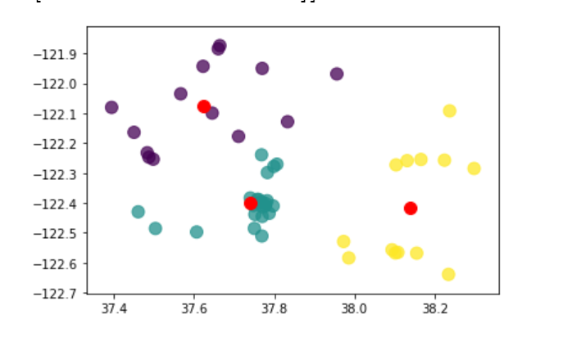
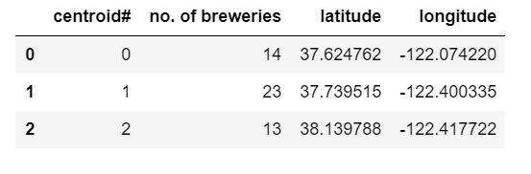
SFO brewery neighborhood and clusters
3 clusters (purple, green, yellow)
Red dots are centroids for the clusters
Locations of centroids and number of breweries listed in the table below.

Slide 5
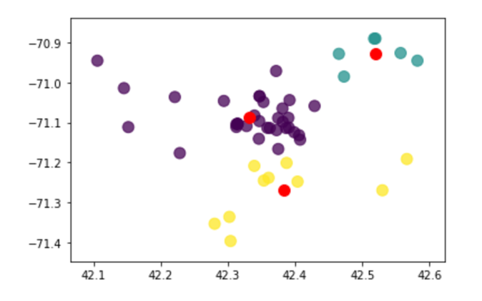
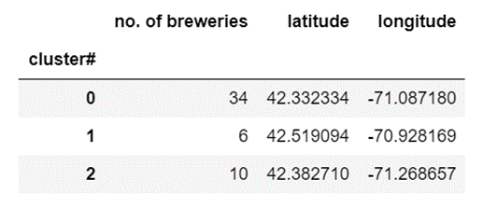
BOSTON brewery neighborhood and clusters
3 clusters (purple, green, yellow)
Red dots are centroids for the clusters
Density in one of the clusters is high!
Locations of centroids and number of breweries listed in the table below.

Slide 6
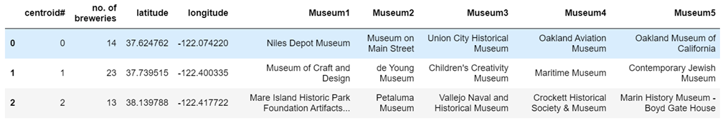
Secondary parameter of interest - Museum
SFO location - Top 5 museums around each cluster are added on to the cluster table

Slide 7
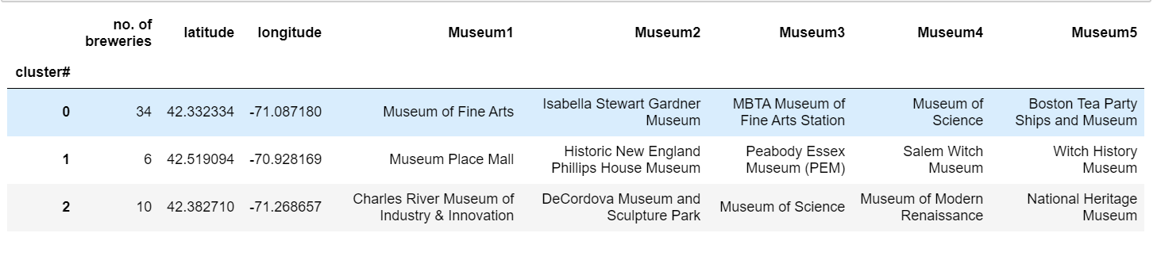
Secondary parameter of interest - Museum
Boston location - Top 5 museums around each cluster are added on to the cluster table

